Slide 1
ANZ EXPLORATORY DATA ANALYSIS TASK
BY
KEHINDE BAASIT KEHINDE

Slide 2
Objectives
Project Description
About the dataset
Exploratory data analysis and data visualization

Slide 3
Project description
The project is about getting insight from a given dataset, that is, ‘exploratory data analysis. It also include some visualizations of transaction volume and some other import insights that can be used in decision making.

Slide 4
About the dataset
The synthesised transaction dataset contains 3 months’ worth of transactions for 100 hypothetical customers. It contains purchases, recurring transactions, and salary transactions.
The dataset is designed to simulate realistic transaction behaviours that are observed in ANZ’s real transaction data.

Slide 5
Exploratory data analysis
The dataset contains 23columns and 12043rows. The total number of authorized status is 7717 while that of posted status is 4326. The count of card present flag with 1.0 is 6194 while that of 1.0 is 1523. There is an increase in the daily transaction rate which is very good and will help the company in maximizing profit. The highest transaction, 174transactions was made on 28th of September, 2018.
The customer with highest number of transaction is customer with ID, CUS-2487424745, she did 578transactions in different states. The customer with the lowest number of transactions is customer with ID, CUS-1739331018. It is advisable to have customer retention plan for the customer with the highest number of transactions and there should be improvement in what you are selling in order to impress the customer with the lowest number of transactions. The age range of all the customers is between 18 and 78.
The age group of most of the customers is 18-29, which means we should focus on th youth, it is followed by age groups 30-30 and 40-49, those age groups are quite high too and we should focus on them. There’s a very low count for people above 70years of age.

Slide 6
Exploratory data analysis
Most of our customers are from the states of NSW and QLD, there should be a good focus plan for them. It should be noted that almost all customers has brought something in more than one state before which means we are not losing any customer even if they move to another state.
Our customers are mostly males and we should focus on them, there should be a good plan for the female customers too, it’s important to attract them.
The average transaction amount of the male gender is always more than that of the female customers, so, there should be a good focus plan on the male customers.
The sum of all transactions made is 2263284.2AUD. The sum of all August transactions is 729935.52AUD, that of September is 730550.2AUD and that of October is 802798.5AUD. There is a good increase in transaction amount every month, that means the business is going well

Slide 7
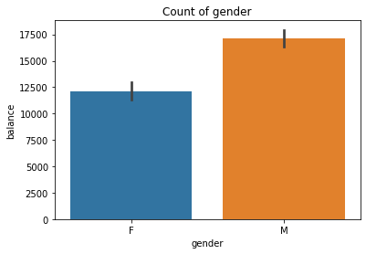
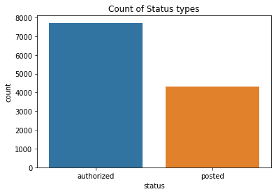
Data VISUALIZATION

Slide 8
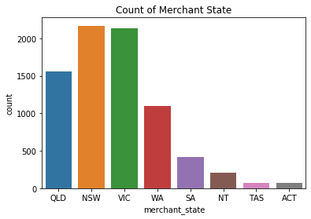
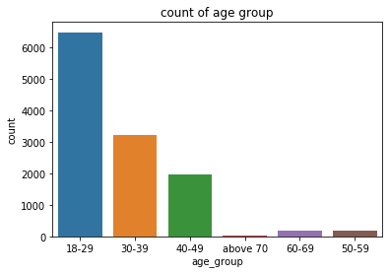
Data visualization

Slide 9
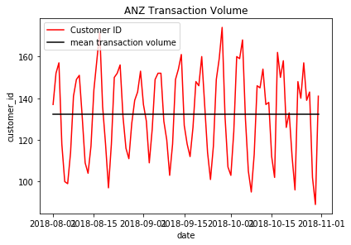
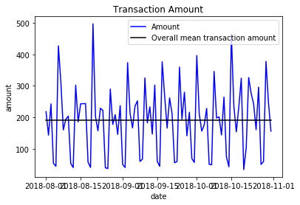
Transaction volume and overall transaction amount

Slide 10
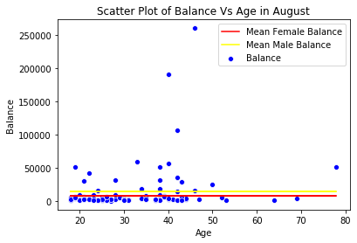
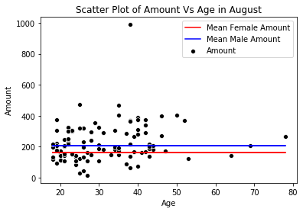
The average customer balance and payment amount generated by Age and Gender for the month of August

Slide 11
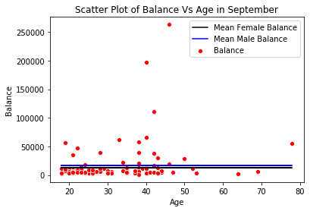
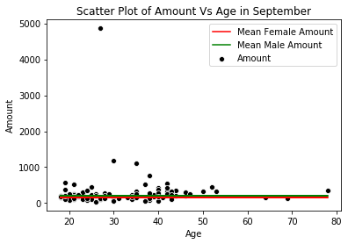
The average customer balance and payment amount generated by Age and Gender for the month of September.

Slide 12
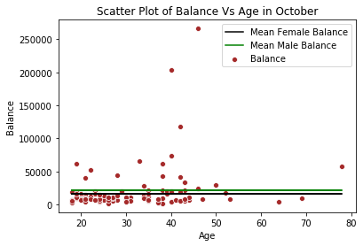
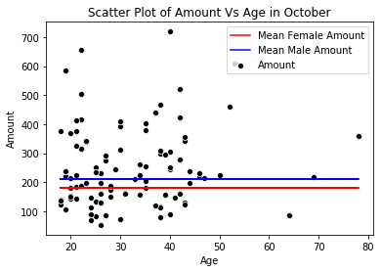
The average customer balance and payment amount generated by Age and Gender for the month of October.

